Slide 1
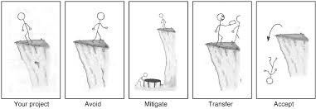

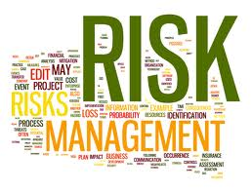
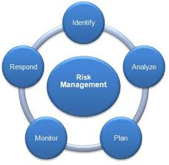
RISK MANAGEMENT

Slide 2
What is a Risk?
A risk is the likelihood of something happening that will have an impact on the achievement of our objectives.
Remember a risk arises as much from failing to capture opportunities when you are looking to achieve your objectives, as it does from a threat that something bad will happen.

Slide 3
What is Risk Management?
Risk Management is about adopting a planned and systematic approach to the identification, evaluation and control of those risks, which can threaten the objectives, assets, or financial wellbeing of the Council.
It is a means of minimising the costs and disruption to the Council caused by undesired events. The aim is to reduce the frequency of risk events occurring, wherever possible, and minimise the severity of their consequences if they do occur.
Risk Management covers the whole spectrum of risks and not just those associated with finance, health & safety and insurance.

Slide 4
What is Risk Management?
Risk Management is not about being ‘risk averse’ – it is about being ‘risk aware’. Risk is ever present and some amount of risk taking is inevitable if the Council is to achieve its objectives.
Risk Management is about making the most of opportunities and about achieving objectives once those decisions have been made. By being ‘risk aware’ the Council is in a better position to avoid threats and take advantage of opportunities.

Slide 5
What is Risk Appetite?
Risk appetite is defined as the amount and type of risk an organisation is prepared to seek, accept or tolerate.
It enables the Council to provide assurance to its stakeholders that it has established clear boundaries for overall risk taking to increase its rewards by accepting calculated risks within an accepted level of authority.
The Council’s overriding attitude to risk is to operate in a culture of creativity and innovation, in which risks are identified in all areas of the business, are understood and proactively managed, rather than avoided.

Slide 6
What type of risks do we face?
The main types of risks faced by local authorities fall into two categories:
Strategic risks
Operational risks
In addition, we have key risk areas that impact both strategically and operationally such as Project/Programme and Partnerships risks.

Slide 7
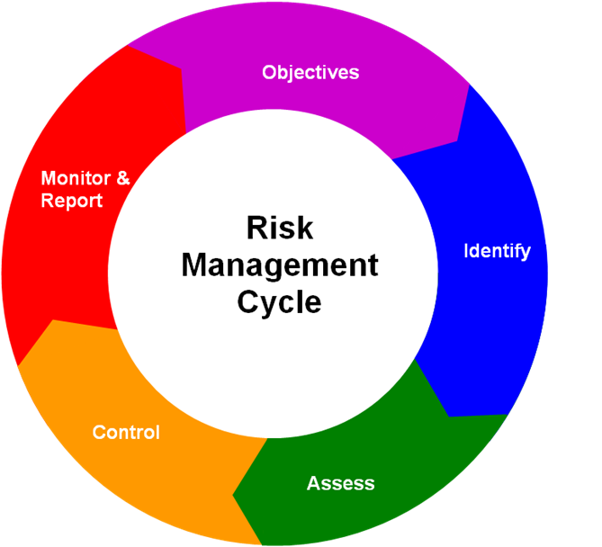
So, what are the arrangements for managing our risks?
To manage our risks effectively, they need to be systematically identified, analysed, controlled and monitored. The key stages in the risk management cycle are illustrated in the diagram below:
Clarifying our objectives
Monitoring,
reviewing and
reporting risks
Identifying our risks
Risk control
Risks Analysis & Evaluation

Slide 8
How do I identify and categorise a risk?
By using the Risk and Opportunity Rainbow
Reputation
Partnerships
People
Governance
Contractual/Suppliers
Financial
Commission/Procurement
Information/Knowledge
Community
Physical Assets
Environmental
Service Continuity
Health & Safety
Legislative & Regulatory
Technological
Programme/Projects
Social
Customer/Client
Fraud
Economic
Delivery
Political
This list is NOT exhaustive , and the categories can interlink between
Strategic and Operational risks

Slide 9
How do we score a risk?
By using the Risk Matrix
RISK
IMPACT / CONSEQUENCE
LIKELIHOOD
1
2
3
4
5
Insignificant
Minor
Moderate
Major
Critical
Almost Certain
(5)
5
10
15
20
25
Highly Likely
(4)
4
8
12
16
20
Probable (3)
3
6
9
12
15
Possible
(2)
2
4
6
8
10
Rare
(1)
1
2
3
4
5

Slide 10
Guidance on Likelihood Ratings
Score
Description
Indicative Guidelines
5
Almost Certain
Is expected to occur in most circumstances
Will undoubtedly happen, possible frequency e.g. annually or more frequently
Imminent/near miss
4
Highly Likely
Will probably occur in many circumstances
Will probably happen, but not a persistent issue e.g. once in 3 years
Has happened in the past
3
Probable
Could occur in certain circumstances
May happen occasionally, e.g. once in 10 years
Has happened elsewhere
2
Possible
May occur only in exceptional circumstances
Not expected to happen, but is possible e.g. once in 25 years
Not known in the activity
1
Rare
Is never likely to occur
Very unlikely this will ever happen e.g. once 100 years

Slide 11
Guidance on Impact Ratings
Insignificant
Minor
Moderate
Major
Critical
1
2
3
4
5
Business Impact
Would have little or no effect on operational/project or strategic objectives
Would impact the efficiency or effectiveness of an area but would not result in the complete failure of operational/project or strategic objectives
Would result in the failure of operational/project objectives but would not put the achievement of strategic objectives at risk or have a wider impact across the authority
Would impact performance of one or more strategic objectives but would not put the authority as a whole at risk
Would result in the failure to fulfil the authority’s statutory responsibilities.
Less than £5k
£5K - £50K
£50K - £0.5m
£0.5m - £1m
Greater than £1m
Income Impact
(One off sum or accumulative in one financial year)
Expenditure Impact
(One off sum or accumulative in one financial year)
Less than £5k
£5K - £50K
£50K - £0.5m
£0.5m - £1m
Greater than £1m
Environmental Impact
On site environmental exposure immediately contained, with low cost impact
On site environmental exposure contained after prolonged effort, with minor cost impact
On site environmental exposure contained with outside assistance, with moderate cost impact
Off site environmental exposure contained with outside assistance with high cost impact
Environmental exposure off site with detrimental effects, with very high cost impact

Slide 12
Guidance on Impact Ratings
Insignificant
Minor
Moderate
Major
Critical
1
2
3
4
5
Reputation Impact
Would reduce the authority’s reputation with a small groups/individuals for a limited timescale e.g. one month
Would reduce the authority’s reputation with limited groups of stakeholders for a limited timescale e.g. two months
Would reduce the authority’s reputation with groups of stakeholders for an extended timescale e.g. three months
Would significantly reduce the authority’s reputation with key stakeholders for an extended timescale e.g. six months and raise concerns with relevant external bodies
Would significantly reduce the authority’s reputation with key stakeholders for an extended timescale e.g. over 1 year and result in direct intervention by relevant external bodies
Legal Impact
Non-compliance by individual staff members
No court proceedings/appropriate regulatory body intervention: no disruption to scheduled services
Court proceedings/appropriate regulatory body intervention but no disruption to scheduled services
Court proceedings/appropriate regulatory body intervention and disruption to scheduled services
Fine/appropriate regulatory body intervention and significant disruption to scheduled services over an extended period of time i.e. over 1 year
Client/Customer
Service Impact
(incl Due Regard & Social Value Act)
Little or no impact on service provision to customers/clients
Impact on service provision to an isolated number of customers/clients or small group
Extended impact on service provision to a small group of customers/clients
Impact on service provision to significant group of customers/clients
Extended impact on service provision to significant group of customers/clients
Would reduce the performance/morale of individuals for limited timescale e.g. one month or increase the likelihood of redundancy
Would reduce the performance/morale of a small number of staff for limited timescale e.g. two months
Would reduce the performance/morale of a number of staff for extended timescale e.g. three months
Would significantly reduce the performance/morale across the authority and result in localised industrial action
Would significantly reduce the performance/morale across the authority and result in extended industrial action
Staff Impact
(incl Due Regard)

Slide 13
Where can I get further information?
Risk Management Toolkit (also available on Staffnet)
Sally Coates – Senior Risk Management Advisor
(01452 425582)
 sally.coates@gloucestershire.gov.uk
Theresa Mortimer – Chief Internal Auditor: Internal Audit, Risk Management & Insurance Services
(01452 427013)
 theresa.mortimer@gloucestershire.gov.uk
Paul Brown – Audit/Risk Technical Officer
(01452 425914)
 paul.brown@gloucestershire.gov.uk

